Slide 1
2016 U.S. Elections
Drivers behind Democratic counties voting for Republicans

Slide 2

Team
Chinchu JOHN
Jonathan OROZCO
Christine ASSAAD

Slide 3
Project Overview
Project
Drivers behind Democratic counties voting for Republicans in 2016 elections.
Why this Topic?
United States of America is a World leading country. Electing a U.S. President does not only affect the future of Americans, It has significant effects world wide.

Slide 4
Data Sources & Analytical Tools
Data
Tools
Excel
Pandas
Numpy
Matplotlib
Seaborn
Google maps
Bureau of Labor Statistics
Bureau of Economics Analysis
Federal Housing Finance Agency (FHFA)

Slide 5
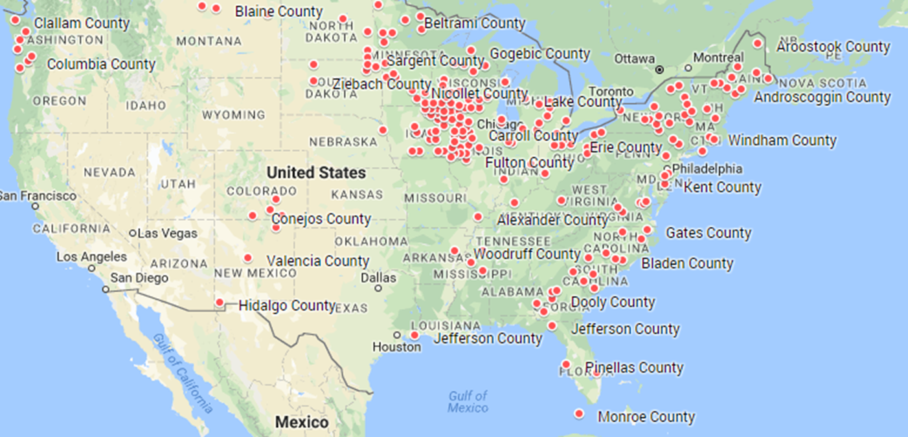
Flipped Counties
206 counties located in 34 states voted for Obama in 2008 & 2012 but helped Trump to win in 2016 with AVG Margin of Votes of 11.4%.
Iowa, with 31, has the most such counties.

Slide 6
Let’s Test Some Relationships
What had possibly pushed these counties to vote for Trump?
Could it be Unemployment Rate?
Could it be Annual Per Capita Income?
Could it be Housing Prices?
These are the questions we will try to answer in the coming slides

Slide 7
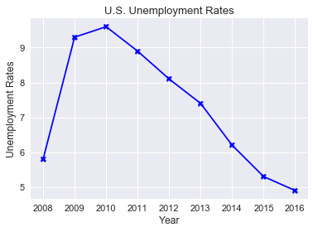
U.S. Overall Unemployment Rates
Year | Annual Unemployment (%)
2008 | 5.8
2009 | 9.3
2010 | 9.6
2011 | 8.9
2012 | 8.1
2013 | 7.4
2014 | 6.2
2015 | 5.3
2016 | 4.9
U.S. overall unemployment rate was 5.8% in 2008 and started to increase to reach its peak in 2010 with 9.6% before it dropped to 4.9% in 2016

Slide 8
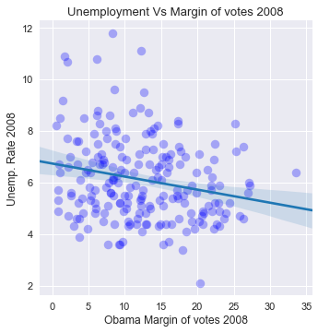
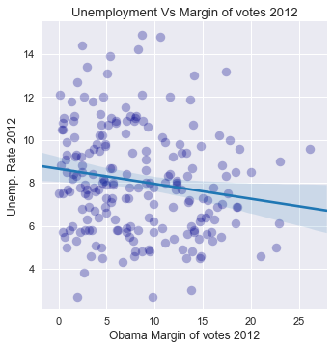
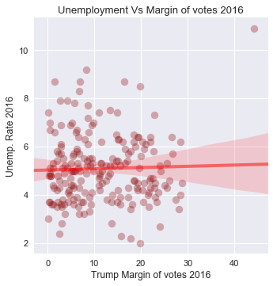
Unemployment Rate of flipped counties
It seems that the unemployment rate in these counties in not a significant driver of voting changes in favor of the Republicans.
Although the Unemployment rates are lower in 2016 compared to 2012 and 2008, Trump margin of votes seems to be higher.

Slide 9
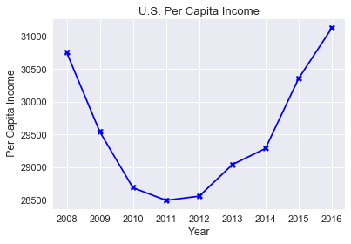
U.S. Per Capita Income
Year | USD
2008 | 30755
2009 | 29542
2010 | 28687
2011 | 28494
2012 | 28558
2013 | 29041
2014 | 29288
2015 | 30358
2016 | 31128
U.S. Per Capita Income which measures the average income earned per person dropped by 7% from 2008 to 2011.
It’s however increased in 2016 by 9% compared to last elections’ year, 2012.

Slide 10
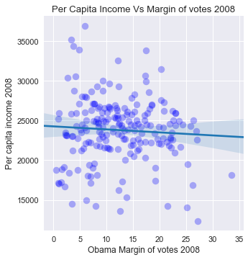
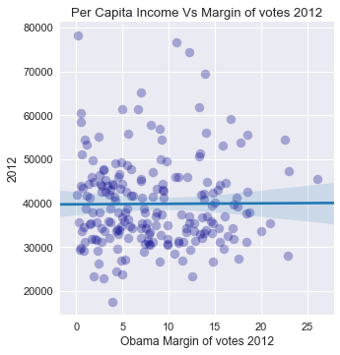
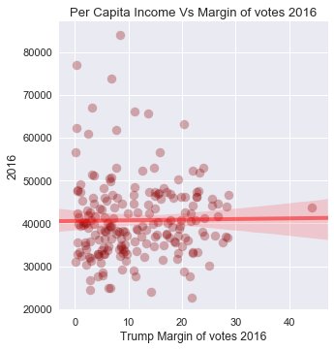
Per Capita Income for flipped Counties
Comparing 2012 to 2016 Per Capita Income for flipped counties, we could tell that there was no significant change that could justify shifting from Democrats to Republicans.
Per Capita Income is not a significant votes’ driver for our 206 counties.

Slide 11
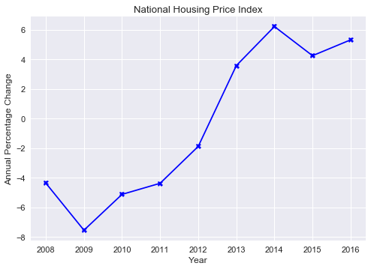
U.S. National House Price Index (HPI)
Year | Annual Change (%)
2008 | -4.37
2009 | -7.55
2010 | -5.13
2011 | -4.38
2012 | -1.89
2013 | 3.57
2014 | 6.21
2015 | 4.24
2016 | 5.31
House Price Index (HPI) provides an analytical tool for estimating changes in the rates of mortgage defaults, prepayments and housing affordability. On a National level, we can see that The HPI increased significantly from in 2012 and continued to increase in 2016 compared to 2008.

Slide 12
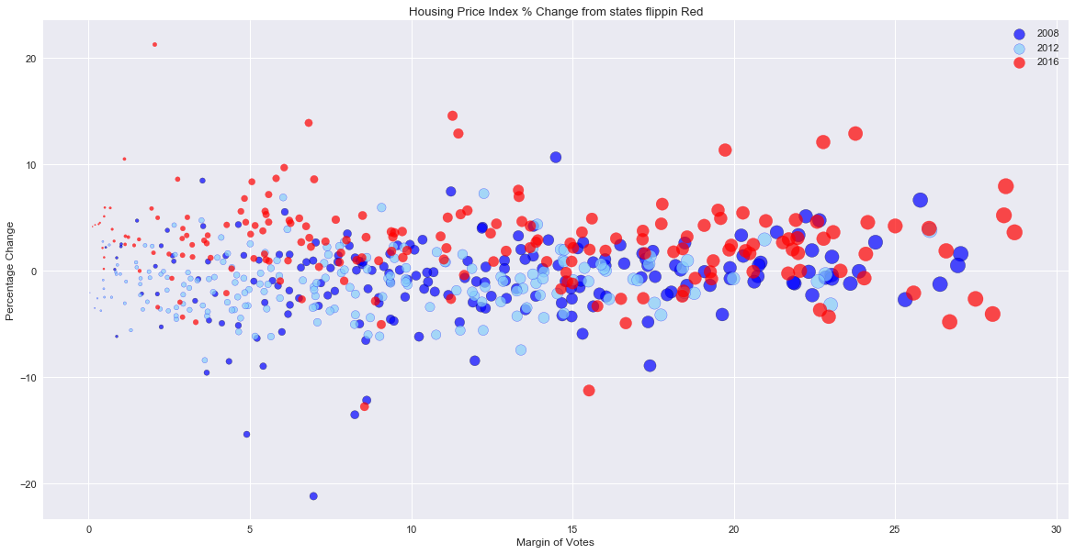
HPI for flipped Counties
Despite the increase in HPI, it does not seem to have significant effect on Trump margin of votes.

Slide 13
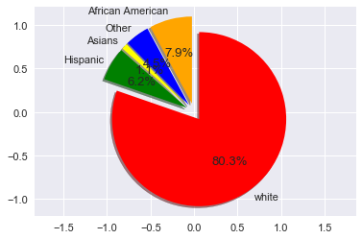
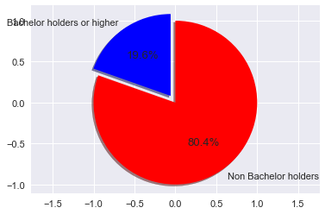
The Counties Demographics
Could this shed some light on reasons behind electing Trump?
80% of counties populations is white with only 20% with bachelor’s degrees or higher.
112 counties (54%) are above average US Persons in Poverty %. They are at 16% Vs 14% Nationwide.

